Slide 1
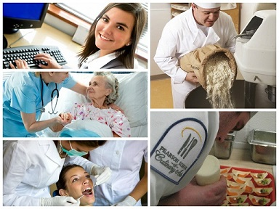
An overview of our vocational programs

Slide 2
An overview
FOOD SECTOR (Pearson School of Culinary Arts / Centre of Expertise)
BUSINESS SECTOR
HEALTH SECTOR (Centre of Expertise)

Slide 3
FOOD SECTOR
Bread Making
Food & Beverage Services
Pastry Making
Professional Cooking
Retail Butchery
Market Fresh Cuisine

Slide 4
BUSINESS SECTOR
Accounting Studies
Administrative Assistance
Medical Secretarial Studies
Starting a Business

Slide 5
HEALTH SECTOR
Dental Assistance*
Health Assistance & Nursing Care
Institutional and Home Care Assistance
Pharmacy Technical Assistance*
*unique to PACC Career Centre

Slide 6
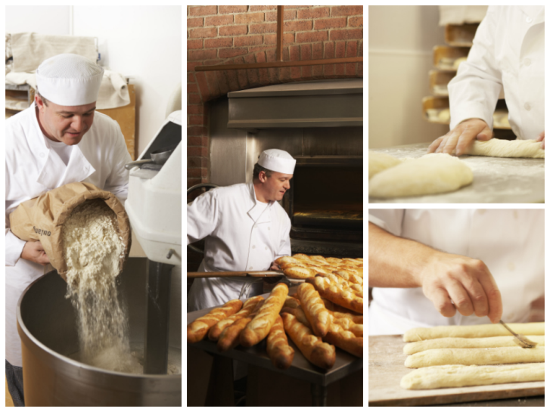
BREAD MAKING 795 hours (7 Months) D.E.P.
Student profile
physically fit, hardworking, passionate, motivated, can handle a flexible work schedule and must be bilingual
Min. Prerequisites
Secondary Ill credits in English, Second Language and Mathematics

Slide 7
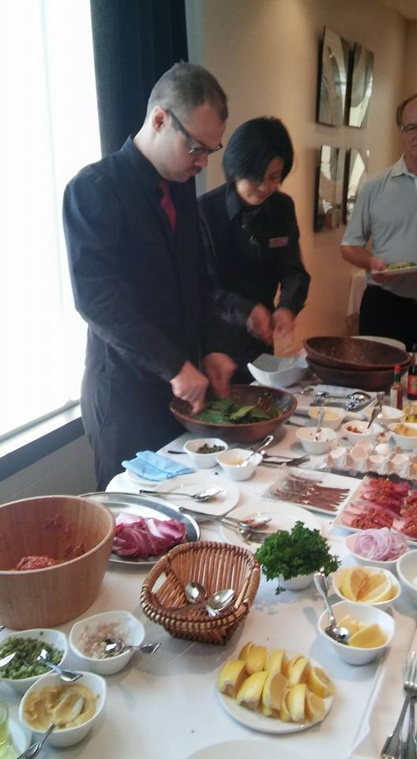
FOOD AND BEVERAGE 960 HOURS D.E.P.
Student profile
adaptable, people oriented, open, curious, hard working, bilingual
Min. Prerequisites
Secondary Ill credits in English,
Second Language and Mathematics

Slide 8
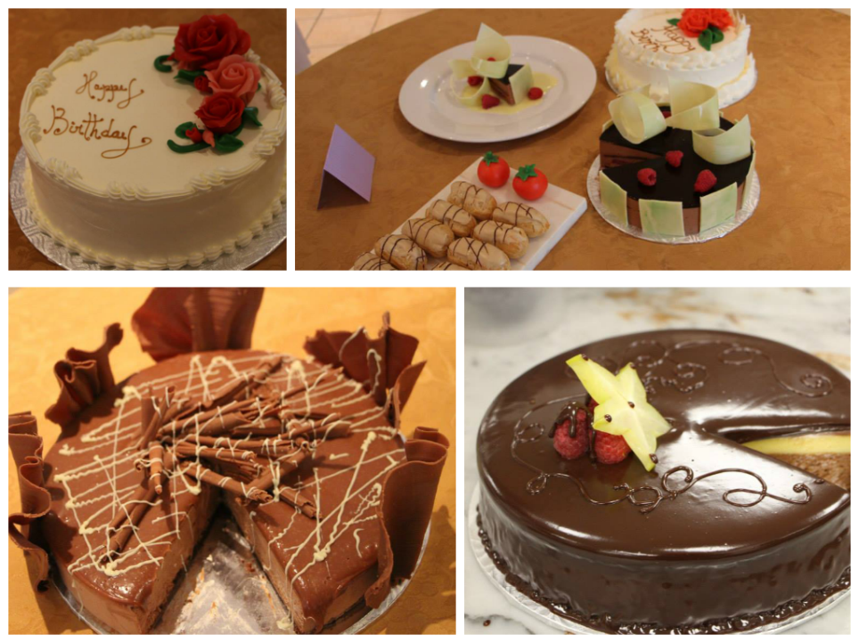
PASTRY MAKING 1350 Hours (13 months) D.E.P.
Student profile
creative, artistic, detail-oriented, passionate, team player, punctual
Min. Prerequisites
Secondary IV credits in English, Second Language and Mathematics

Slide 9
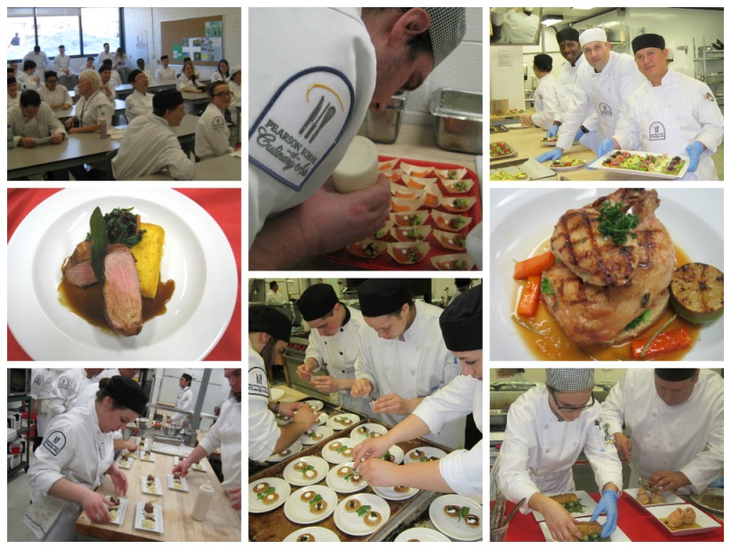
Professional Cooking 1470 HOURS (14 MONTHS) D.E.P.
Student profile
team player, physically fit, punctual, can perform under pressure, meticulous and can handle a flexible work schedule
Min. Prerequisites
Secondary IV credits in English, Second Language and Mathematics
Notes:
My son is just finishing up sciences at John Abbott and has just put in his application for the August cooking group…he’s really excited!

Slide 10
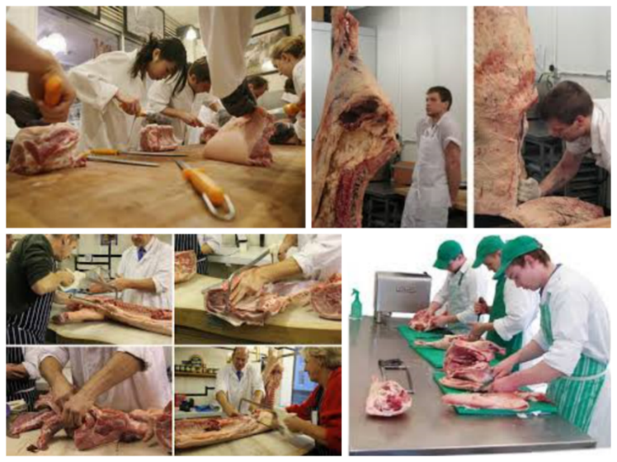
RETAIL BUTCHERY 900 hours (8-9 Months) D.E.P.
Student profile
hardworking, physically fit, can work in the cold, meticulous, patient, passionate, team player, can communicate in French
Min. Prerequisites
Secondary Ill credits in English, Second Language and Mathematics

Slide 11
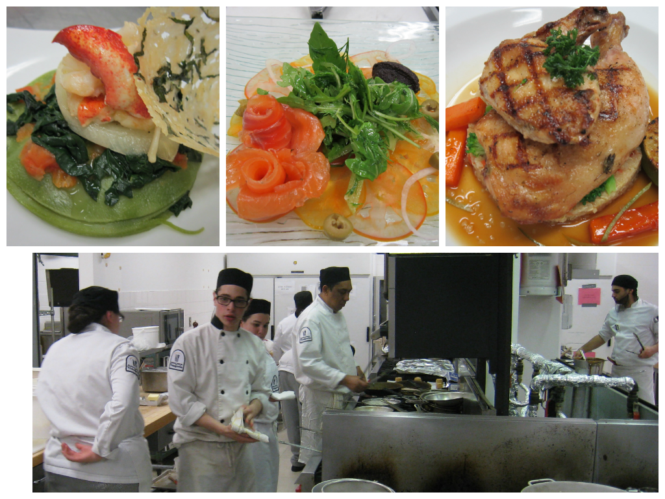
MARKET-FRESH CUISINE 525 hours A.V.S.
Student profile
passionate, dynamic, flexible, physically fit
Min. Prerequisites
DEP in Professional Cooking or relevant industry experience

Slide 12
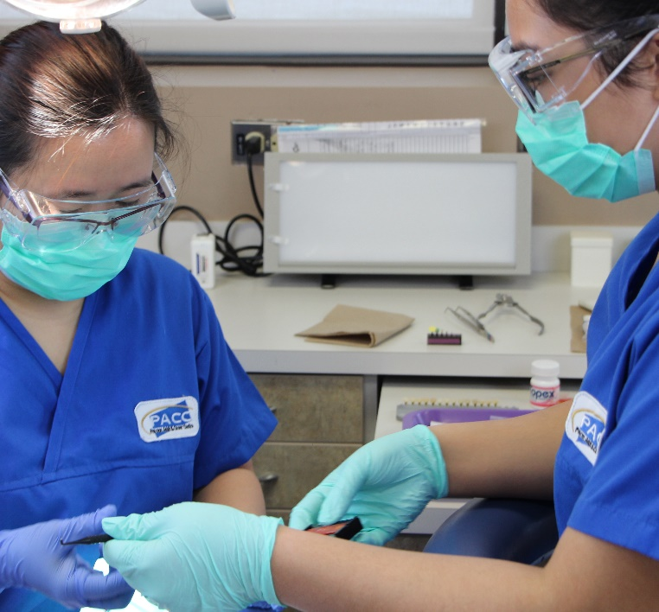
DENTAL ASSISTANCE 1500 hOUrs (13 months) D.E.P
Student profile
detail oriented, good communicator, compassionate, empathetic, team player
Min. Prerequisites
Secondary IV credits in English, Second Language and Mathematics

Slide 13
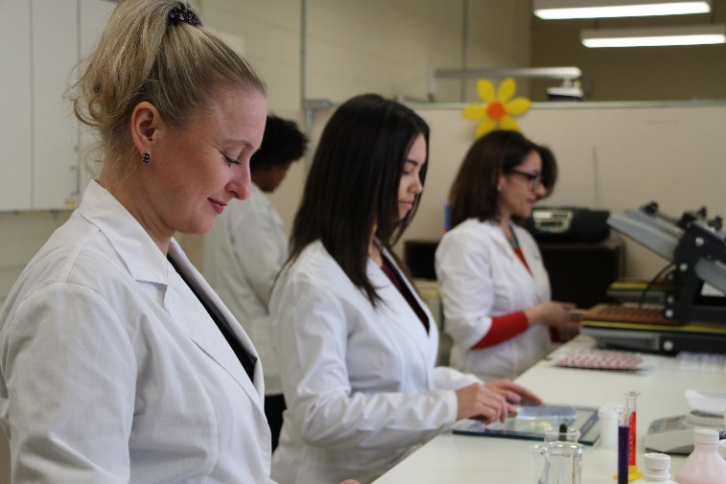
PHARMACY TECHNICAL ASSISTANCE 1230 hOURS (10 months) D.E.P.
Student profile
detail oriented, great communication skills, team player, good math skills, excellent memory, must be bilingual
Min. Prerequisites
Secondary IV credits in English Second language and mathematics

Slide 14
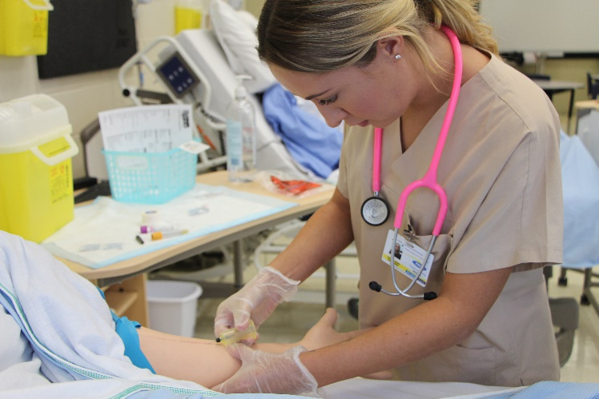
Health Assistance & Nursing Care 1800 hOURS (22 months) D.E.P.
Student profile
detail oriented, great communication skills, team player, good math skills, excellent memory, must be bilingual
Min. Prerequisites
Secondary V credits in language of instruction and Secondary IV credits in second language and mathematics

Slide 15
Institutional and Home Care Assistance 870 hOURS (9 months) D.E.P.
Student profile
detail oriented, great communication skills, team player, good math skills, excellent memory, must be bilingual
Min. Prerequisites
Secondary III credits in language of instruction, second language and mathematics in the programs of study

Slide 17
testimonial:
“PACC Career Centre is one of the most exciting places I’ve ever studied at. The building is brimming with opportunities for hands-on learning and possible opportunities for career success. The teachers are passionate about what they do, and the facilities are absolutely top notch.” BRIONY BLAKE-OXTON Graduate

Slide 18
Take-homes…
Vocational Education is not just an ‘alternative’ path or a ‘plan B’. It’s just as viable an option as any other.
By learning through doing, our graduates are among the first to be hired in their career of choice.

Slide 19
Thank you very much for your time! ☺

