Slide 1
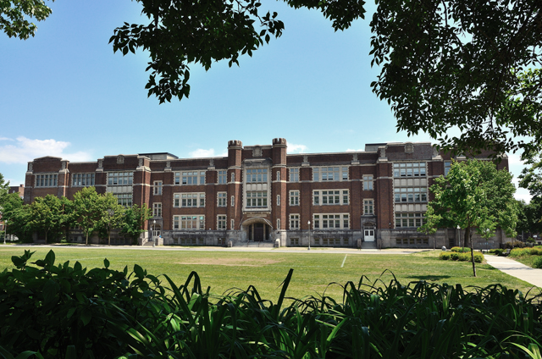


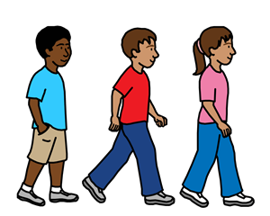

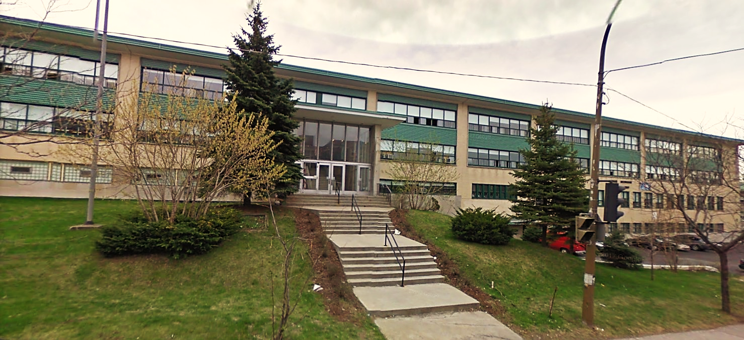
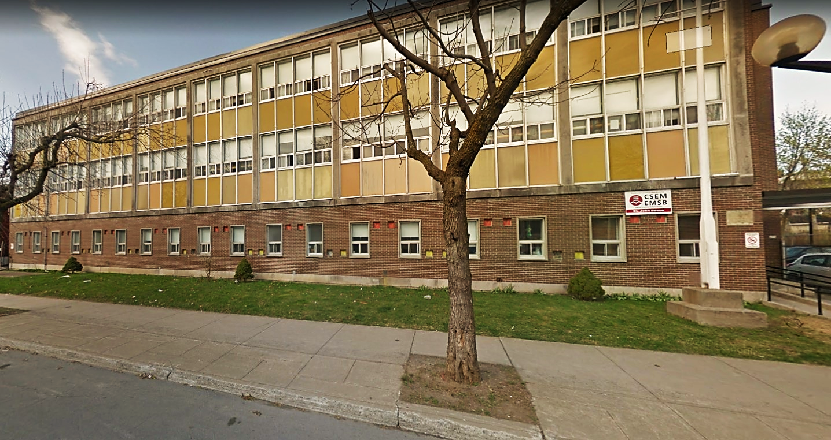
My School is Moving

Slide 2

I’m ________________.
I go to Westmount Park School.
My picture
1

Slide 3




On September 3rd , 2019, Westmount Park School will be in two different buildings. Our old school is being fixed.
Some students are going to one building. Some students are going to another building. They are both Westmount Park School.
2

Slide 4
I am going to this building.
My picture
3

Slide 5
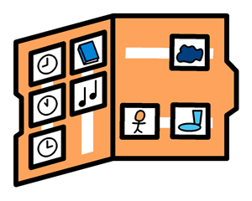
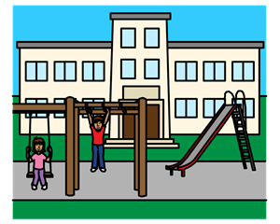
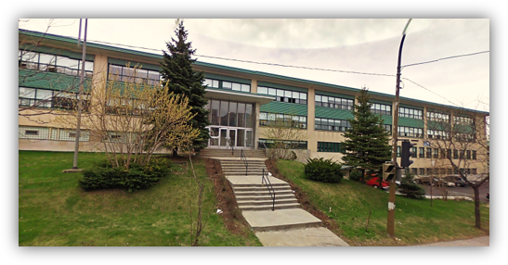
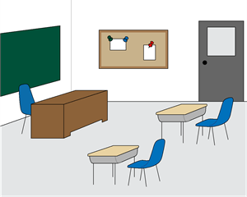
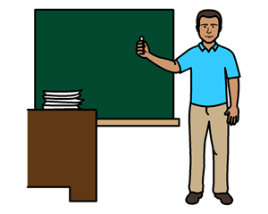
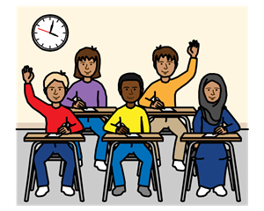
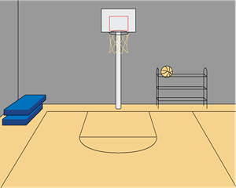
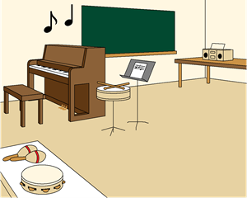
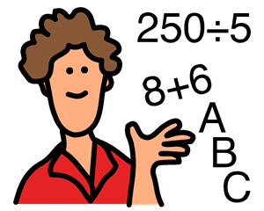
At my new school building, I will have a schedule, classroom, teachers, other children, recess, snack, lunch, music, gym, and more activities.
Some things at school may be different but other things will be the same.
4

Slide 6


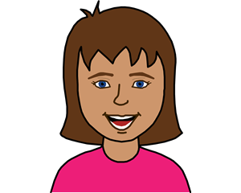
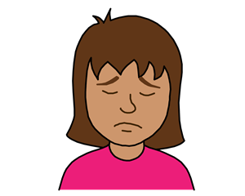

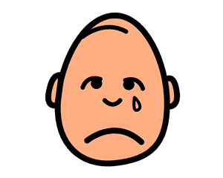
Sometimes I might feel happy and excited!
Sometimes I might feel angry or sad.
5

Slide 7


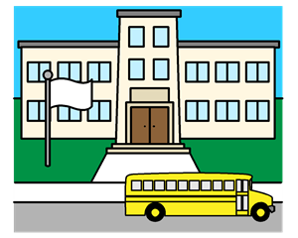
There are people at home and at school who can help me.
6

